Slide 1

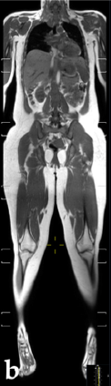
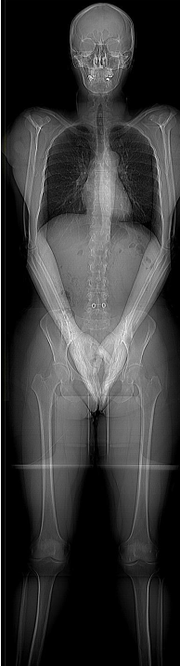
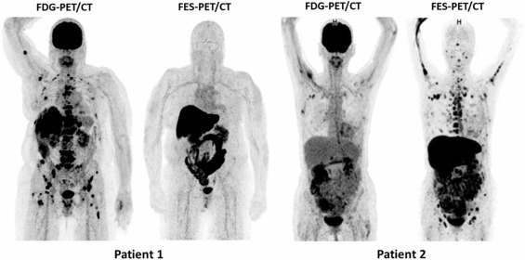
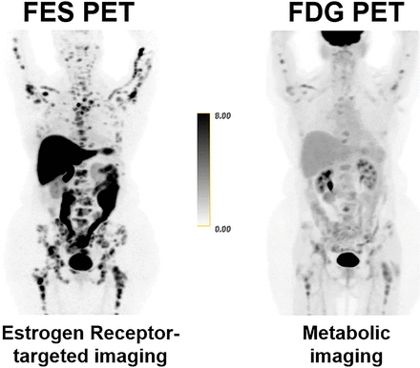
Systemic Imaging in Breast Cancer
Bone scan (scintigraphy), magnetic resonance imaging (MRI), computed tomography (CT), and positron emission tomography (PET) may be used to evaluate mBC. FDG-PET/CT is used to assess for areas of increased metabolic activity while FES-PET/CT is used for detection of ER-positive disease, including invasive lobular cancer (ILC).
Bone Scan
MRI
CT
FDG
FES
  Benefits
  Detects osteoblastic bone metastases across the whole skeleton
  Least expensive, most widely available
  Limitations
  Low specificity as uptake may reflect benign conditions (e.g., arthritis, trauma, degenerative changes)
  Less sensitive for purely lytic lesions and may underestimate disease burden
  Benefits
  Provides soft-tissue contrast, enabling high sensitivity for brain, liver, and marrow metastases
  Radiation-free alternative for systemic staging
  Limitations
  Limited availability and longer scan times
  May generate false positives requiring additional evaluation
  Benefits
  Rapid, widely available imaging
  Detects bone and visceral metastases
  Provides comprehensive anatomic localization to guide biopsy or treatment planning
  Limitations
  Reduced sensitivity for early bone marrow involvement and small peritoneal or nodal metastases
  Uses iodinated contrast which may be contraindicated in some patients
  Benefits
  Detects metabolically active disease
  Useful for assessing treatment response, detecting occult disease, and clarifying indeterminate findings from CT/MRI
  Limitations
  Low uptake in low-grade and lobular breast cancers
  Uptake is nonspecific as inflammation or infection can mimic disease
  Availability may be limited
  Benefits
  Detects ER-positive disease, helpful when other imaging shows discordant findings
  Useful in low-grade and lobular breast cancers
  Limitations
  Interfering medications (SERMs/SERDs) may reduce uptake
  Limited availability
Image adapted from Magdy O, et al. Sci Rep. 2024;14(1):25627.
Image adapted from Omran M, et al. Cancers (Basel). 2022;14(2):380.
Image adapted from Pierro A, et al. Life (Basel). 2021;11(12):1320.
Image adapted from Moustaquim J, et al. EJC. 2025;229:115792.
Image adapted from Ulaner GA, et al. JNM. 2021;62(3):326-331.
Systemic imaging in breast cancer requires tailoring the modality to the tumor’s biology and clinical question,
as each options offers distinct strengths and blinds spots in detecting metastatic disease.
ER, estrogen receptor; mBC, metastatic breast cancer; FDG, Fluorodeoxyglucose; FES, Fluoroestradiol.
MedPDx-00546 | March 2026 May not be reproduced, in whole or in part, without the written consent of GE HealthCare.

