Slide 1
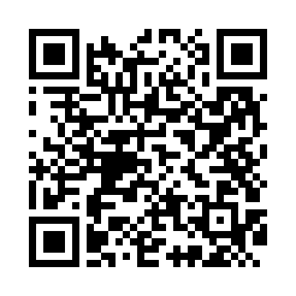
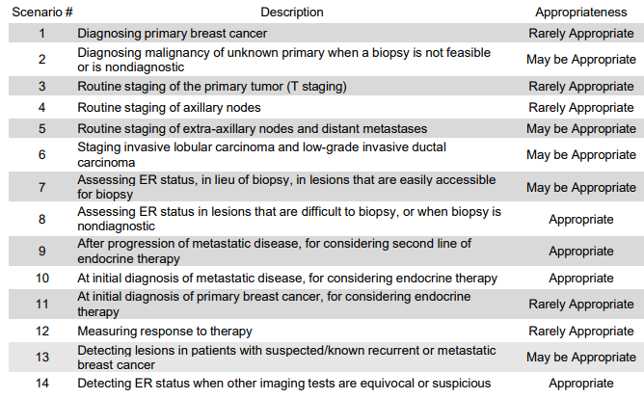
Appropriate Use Criteria for FES PET
The Society of Nuclear Medicine and Molecular Imaging (SNMMI) Appropriate Use Criteria provide expert consensus recommendations to enable appropriate clinical use of FES-PET, more efficient approval of FES by payers, and promotion of investigation into areas requiring further research.¹
FES, fluoroestradiol; ER, estrogen receptor; PET, positron emission tomography;
1. Ulaner GA, et al. J Nucl Med. 2023;64(3):351-354. 2. Expert Panel on Breast Imaging, et al. J Am Coll Radiol. 2024;21(6S):S168-S202.
The American College of Radiology Appropriateness Criteria® Imaging of Invasive Breast Cancer indicate that the use of FES-PET non-invasively characterizes ER ligand-binding function and can be used to detect ER-positive lesions.²
Adapted from Ulaner, GA, et al, JNM 2023 Mar;64(3):351-354

